Slide 1
Lecture 10: Graph Algorithms (IV)
Dr. Tsung-Wei Huang
Department of Electrical and Computer Engineering
University of Utah, Salt Lake City, UT

Slide 2
HW2 Due Today through Email
Sample result
What is the lesson we learned?
BFS-styled propagation works for problems with:
Optimal substructure
Wavefront computing patterns
In shortest path, we maintain wavefront
Relaxation: d[u] + w(u, v) < d[v]

Slide 3
Recap: Maximum Flow Problem
Network flow problem
A flow network G=(V,E): a directed graph, where each edge (u,v)∈E has a nonnegative capacity c(u,v)>=0.
If (u,v)∉E, we can assume that c(u,v)=0.
two distinct vertices :a source s and a sink t.
12
16
20
s
10
9
7
t
4
13
4
14

Slide 4
Flow Constraint
G=(V,E): a flow network with capacity function c.
s -- the source and t -- the sink.
A flow f(u, v) in G must satisfy
Capacity constraint
For all u,v ∈V, we require f(u, v) ≤ c(u, v).
Flow conservation
For all u ∈V-{s, t}, we require
a
d
b
c
a+b = d+c

Slide 5
Objective
The quantity f (u, v) is called the net flow from vertex u to vertex v.
The value of a flow is defined as
The total flow from source to any other vertices.
The same as the total flow from any vertices to the sink.

Slide 6
Example
12/12
11/16
15/20
s
10
t
1/4
4/9
7/7
8/13
4/4
11/14
A flow f in G with value

Slide 7
Method to Compute Maximum Flow
FORD-FULKERSON-FRAMEWORK(G, s, t)
initialize flow f to 0
while there exists an augmenting path p
do augment flow f along p
return f

Slide 8
Residual Network
Residual network defines edges to admit net flow
The amount of additional net flow from u to v before exceeding the capacity c(u,v) is the residual capacity of (u,v), given by:
In the regular direction: c_{f}(u,v)=c(u,v)-f(u,v)
In the opposite direction: c_{f}(v, u)=c(v, u)+f(u, v).
If you flow f from A to B
Subtract the regular direction capacity from f
Add f to the opposite direction capacity
-f
B
A
+f

Slide 9
Example
DFS augments a unit flow in the first iteration
1
1
1
1
1
1
1

Slide 10
Example
Update the residual network
1
1
0
1
0
1
0
1
1
1

Slide 11
Example
Residual network gives a chance to “circle back”
1
1
0
1
0
1
0
1
1
1

Slide 12
Example
DFS augments another unit flow in the second iter
1
1
0
1
0
1
0
1
1
1

Slide 13
Example
Update residual network
0
1
0
0
1
1
1
0
0
0
1
0
1
1

Slide 14
Example
Maximum flow: 2
0
1
0
0
1
1
1
0
0
0
1
0
1
1

Slide 15
Example
Residual network gives us a way to circle flow back
0
The original flow graph
1
0
0
1
1
1
0
0
0
1
0
1
1

Slide 16
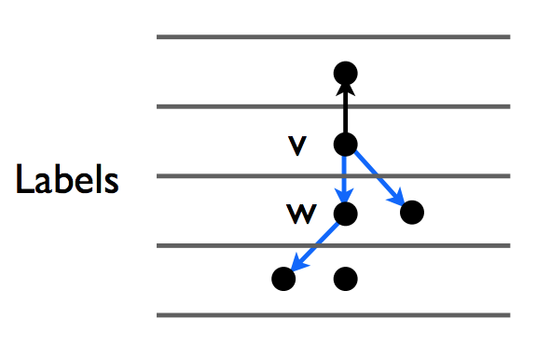
Push-Relabel Algorithm
Main idea
Don’t want complexity to depend on the max flow value
Each node has a label h[v] of a potential (or height)
Route flow from high to low potential
We augment a flow ”downhill” (blue edge)
h[u] → h[v] if there is “flowable” units from u

Slide 17
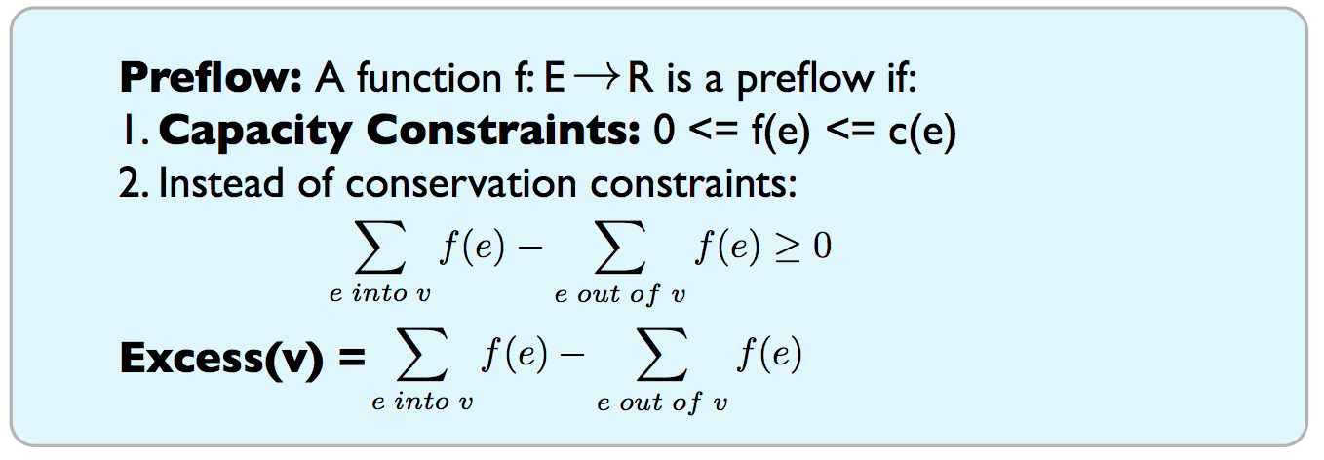
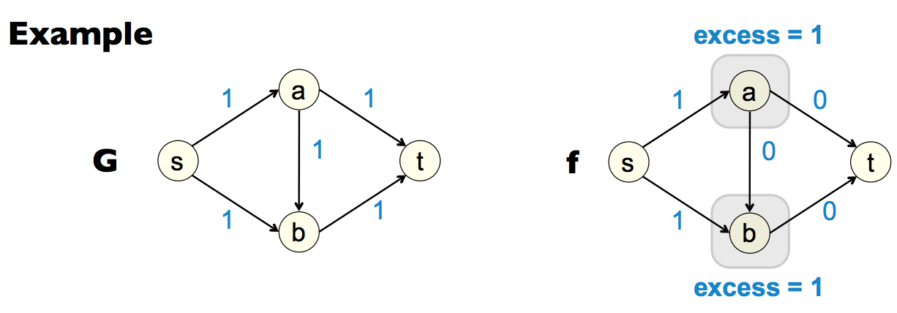
Push-Relabel Algorithm Terminology

Slide 18
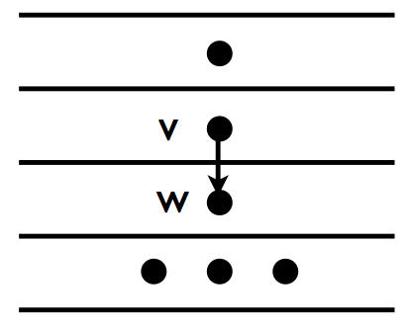
Iterate Two Operations
Push(v, w): applies if excess(v)>0, h(w)<h(v)
f = min(excess(v), c_{f}(v, w))
Add f to f(v, w) and update residual network
Relabel(v): applies if excess(v)>0 and no h(w)<h(v)
Increase h(v) by 1

Slide 19
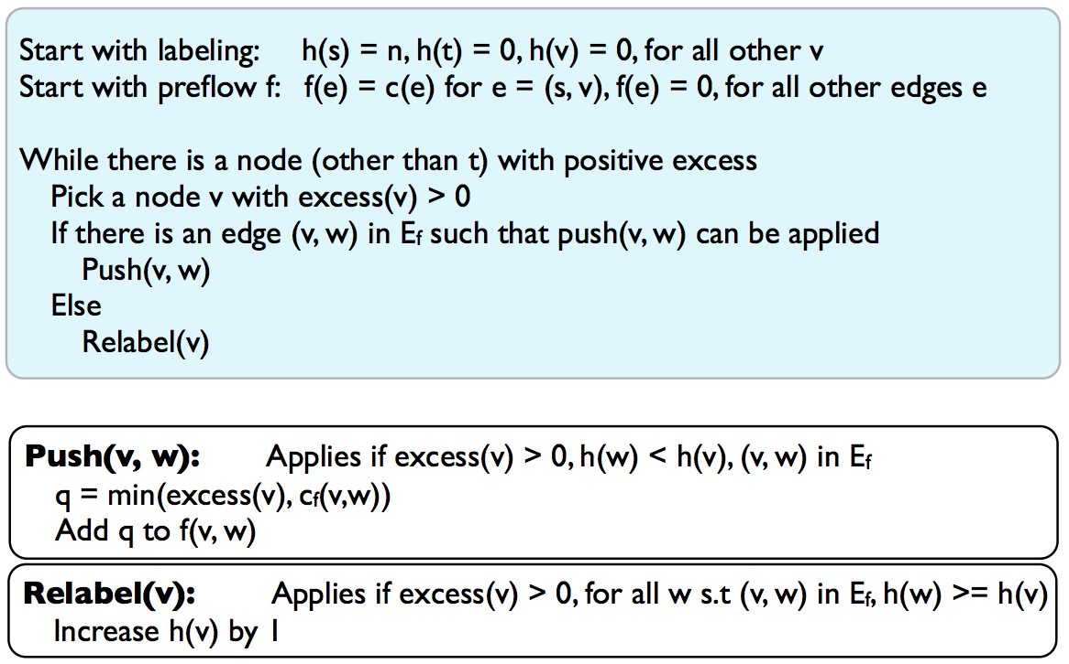
Algorithm (V. Goldberg and R. Tarjan)

Slide 20
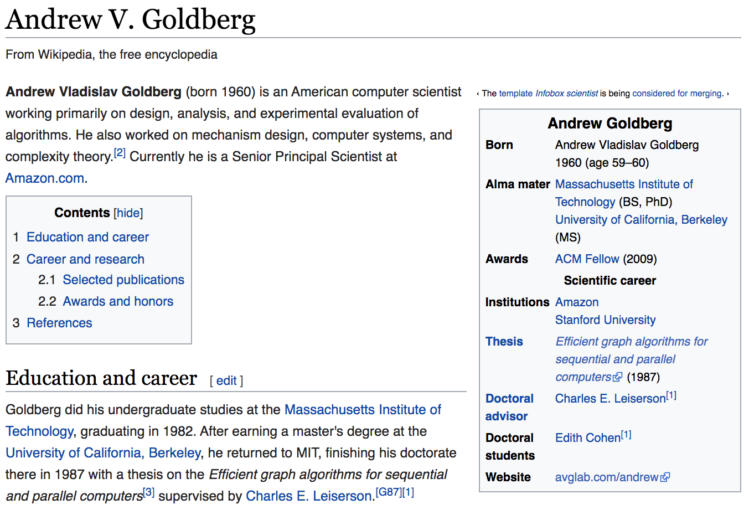

Two Giants …

Slide 21
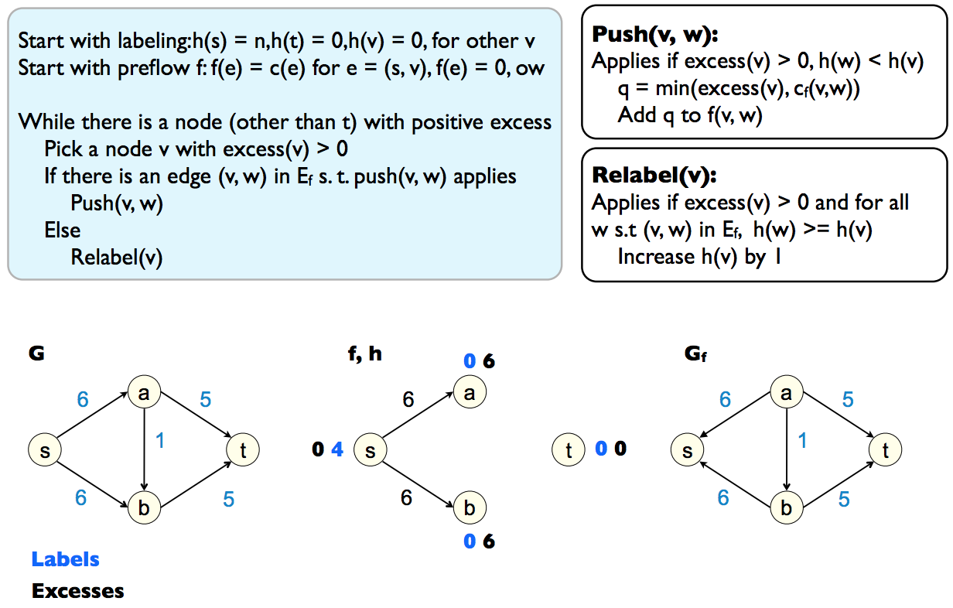
Example
Preflow from source and select a in iteration 1

Slide 22
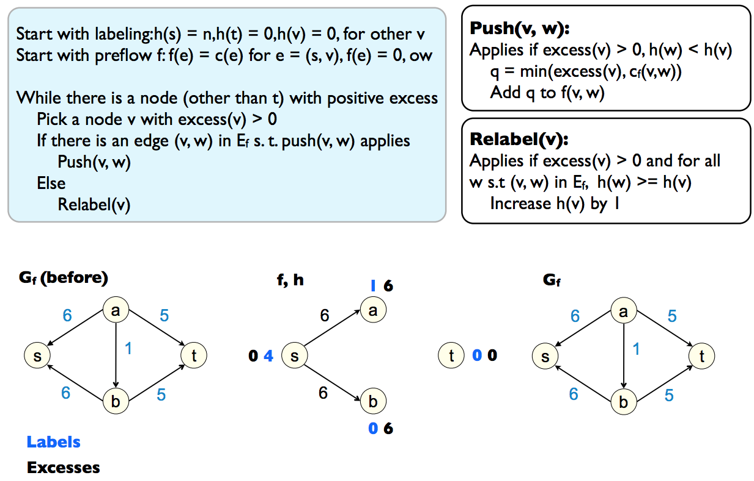
Example
Relabel(a) to increase h[a] by one

Slide 23
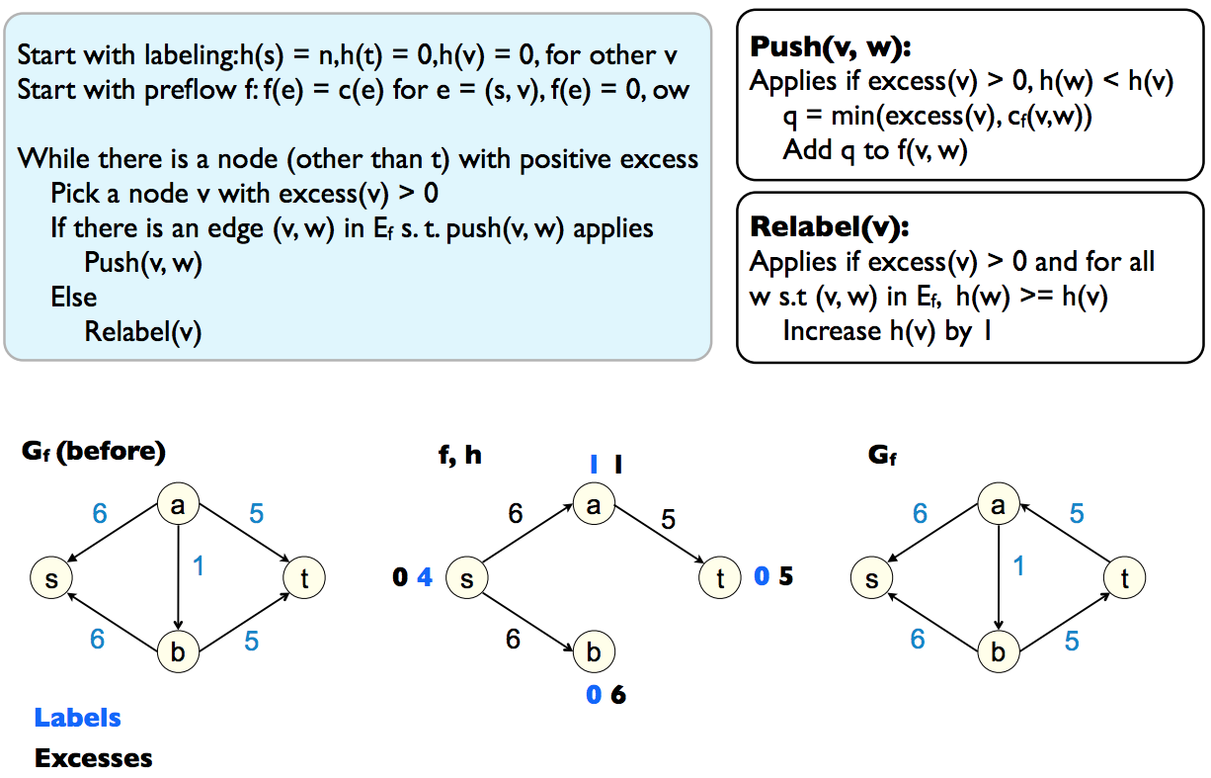
Example
Push(a, t) to add 5 flow along a→t

Slide 24
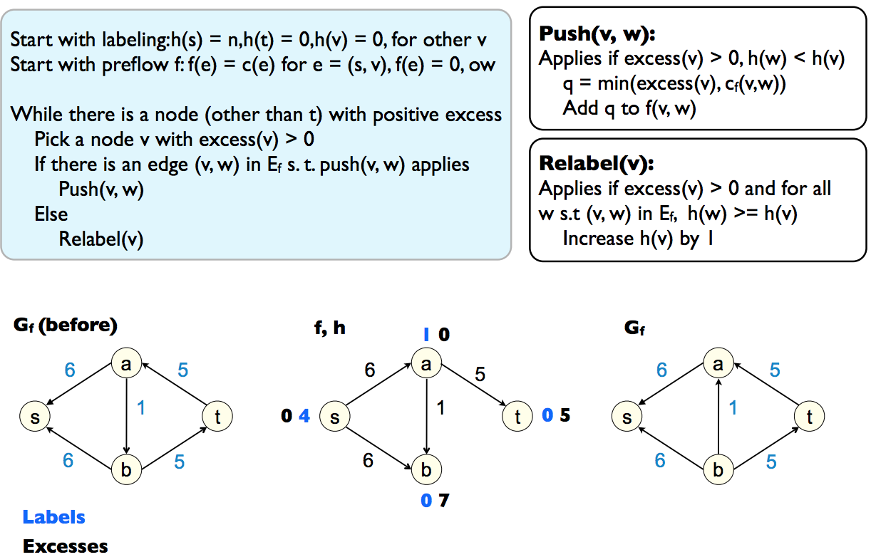
Example
Push(a, b) to add 1 flow along a→b

Slide 25

Example
Relabel(b) to increase h[b] by 1

Slide 26

Example
Push(b, t) to increase flow by 5 along b→t

Slide 27
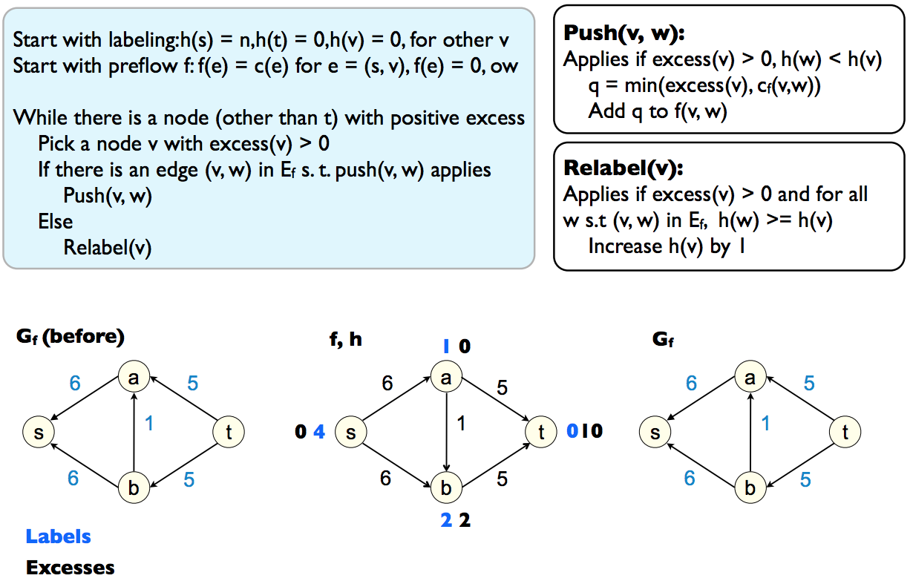
Example
Relabel(b) to increase h[b] by 1

Slide 28

Example
Push(b, a) to increase flow along b→a by 1

Slide 29

Example
Relabel(b) to increase h[b] by 1

Slide 30
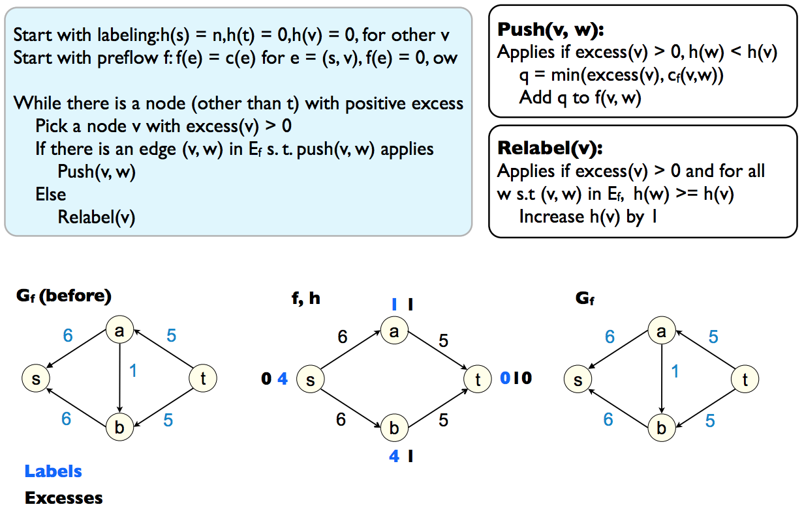
Example
Relabel(b) to increase h[b] by 1

Slide 31
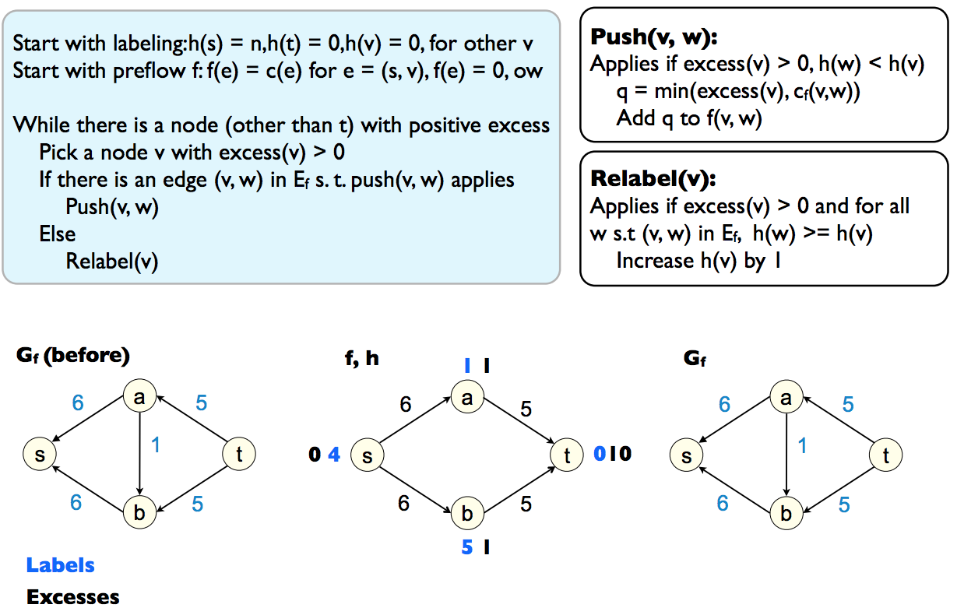
Example
Relabel(b) to increase h[b] by 1

Slide 32

Example
Push(b, s) to increase the flow along b→s by 1

Slide 33
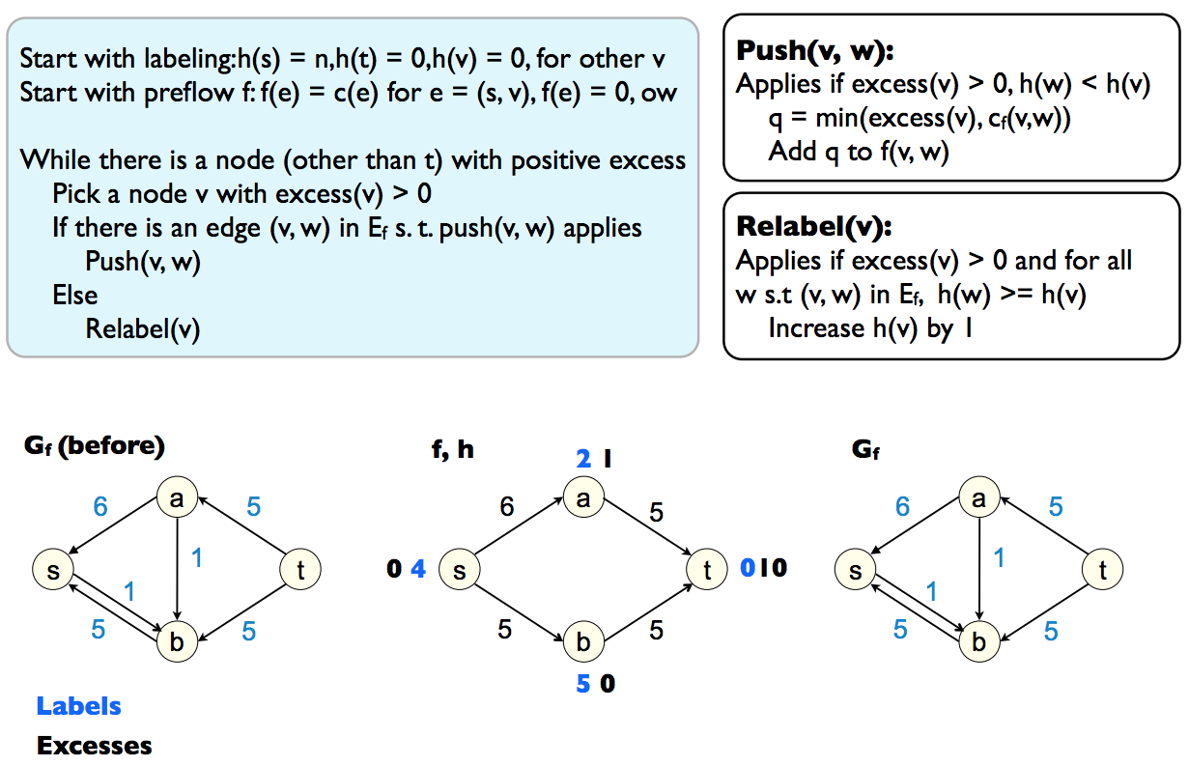
Example
Relabel(a) to increase h[a] by 1

Slide 34
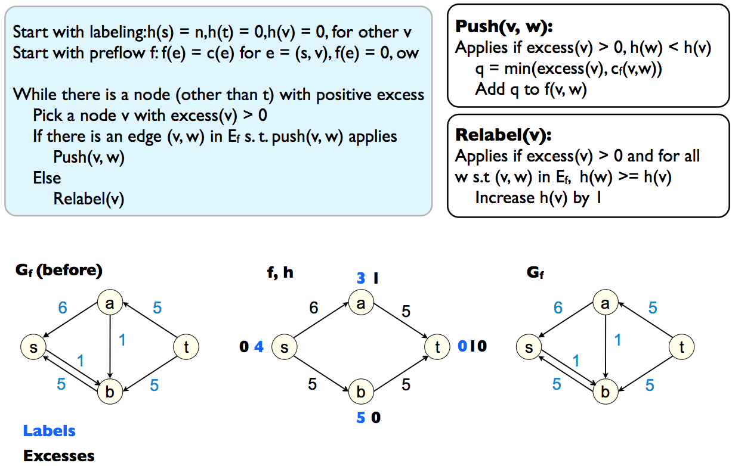
Example
Relabel(a) to increase h[a] by 1

Slide 35

Example
Relabel(a) to increase h[a] by 1

Slide 36

Example
Relabel(a) to increase h[a] by 1

Slide 37

Example
Push(a, s) to increase the flow along a→s by 1

Slide 38
Time Complexity
How many push/relabel operations?
Bound the maximum value of h(v) for any node v
Bound the number of relabel operations

Slide 39
Min-cost Flow
Goal: Build a cheapest network that satisfies the flow constraint
Input:
A directed graph G
A source vertex s
A sink vertex t
A capacity function c on the edges, i.e. c: E->R
A cost function w on the edges, i.e. w: E->R
Output: a maximum s-t flow f which minimizes Σf(e) w(e)
Concept: There can exist multiple maxflow solutions and we want to find the one with the minimum cost

Slide 40
Problem Structure
M-augmenting paths
Bipartite matching
Residual graph
augmenting paths
Maximum flow

Slide 41
Problem Structure
M-augmenting paths
Bipartite matching
Residual graph
augmenting paths
Maximum flow
???
Minimum cost flow

Slide 42
Problem Structure
M-augmenting paths
Bipartite matching
Residual graph
augmenting paths
Maximum flow
Shortest path
???
Minimum cost flow

Slide 43
Problem Structure
M-augmenting paths
Bipartite matching
Residual graph
augmenting paths
Maximum flow
Shortest path
???
Minimum cost flow
Weighted bipartite matching

Slide 44
Algorithm?
Two parameters: value and cost of the flow
Value: maxflow value
Cost: the cost of the maxflow value
Each edge is associated with two values c and w
c is the capacity and w is the cost per unit flow
What is the residual network structure?

Slide 45
Residual Network
f(e) = 2
c(e) = 10
c(e) = 8
c(e) = 2
Max Flow

Slide 46
Residual Network
f(e) = 2
f(e) = 2
c(e) = 10
c(e) = 10, w(e)
c(e) = 8
c(e) = 8, w(e)
c(e) = 2
Max Flow

Slide 47
Residual Network
f(e) = 2
f(e) = 2
c(e) = 10
c(e) = 10, w(e)
c(e) = 8
c(e) = 8, w(e)
c(e) = 2
c(e) = 2, -w(e)
Max Flow
Min-cost Flow

Slide 48
Example
Capacity/Cost
1/2
1/2
1/1
1/1
T
S
1/1
1/2
1/2

Slide 49
Example
Capacity/Cost
1/2
1/2
1/1
1/1
T
S
1/1
1/2
1/2
Find the shortest path

Slide 50
Example
Capacity/Cost
1/2
1/2
0/1
0/1
T
S
0/1
1/2
1/2
Flow=1, cost=3

Slide 51
Example
Capacity/Cost
1/2
1/2
0/1
1/-1
0/1
T
S
1/-1
0/1
1/2
1/2
1/-1
Flow=1, cost=3

Slide 52
Example
Capacity/Cost
1/2
1/2
0/1
1/-1
0/1
T
S
1/-1
0/1
1/2
1/2
1/-1
Find another shortest path

Slide 53
Example
Capacity/Cost
1/2
1/2
0/1
1/-1
0/1
T
S
1/-1
0/1
1/2
1/2
1/-1
Flow=1, cost = 2+2-1+2+2=7

Slide 54
Example
Capacity/Cost
0/2
0/2
0/1
1/-1
0/1
T
S
0/-1
0/1
0/2
0/2
1/-1
Flow=1, cost = 2+2-1+2+2=7

Slide 55
Example
Capacity/Cost
0/2
1/-2
0/2
0/1
1/-2
1/-1
1/1
T
S
0/-1
0/1
0/2
1/-2
0/2
1/-1
1/-2
Flow=1, cost = 2+2-1+2+2=7

Slide 56
Example
Capacity/Cost
0/2
1/-2
0/2
0/1
1/-2
1/-1
1/1
T
S
0/-1
0/1
0/2
1/-2
0/2
1/-1
1/-2

Slide 57
Example
Capacity/Cost
0/2
1/-2
0/2
0/1
1/-2
1/-1
1/1
T
S
0/-1
0/1
0/2
1/-2
0/2
1/-1
1/-2
Flow=1, cost=3 and Flow=1 cost=7

Slide 58
Example
Capacity/Cost
0/2
1/-2
0/2
0/1
1/-2
1/-1
1/1
T
S
0/-1
0/1
0/2
1/-2
0/2
1/-1
1/-2
Flow = 2, cost=10

Slide 59
Minimum Weight Matching (MWM)
Similar to bipartite matching but with weight

Slide 60
Minimum Weight Matching (MWM)
Transform to a flow network with cost
S
T

Slide 61
Minimum Weight Matching (MWM)
Attach capacity and weight
1/0
1/0
S
1/0
1/0
T
1/0
1/0

Slide 62
Minimum Weight Matching (MWM)
Min-cost flow equals MWM

Slide 63
Summary
Debrief on HW2
Maximum flow Ford-Fulkerson algorithm recap
Iterative, simple to implement
Complexity depends on the unknown “maxflow” value
Maximum flow push-relabel algorithm
Iterative with relaxed conservation constraints
Time complexity is O(N³)
Minimum cost maximum flow algorithm

